Slide 1
Software Design
Voltages above a pre-defined threshold count as a knock.
Knock times are stored in milliseconds.
Buttons are active high.
Solenoid opens for 5 seconds.
Red and green LEDs convey information to the user.
Uses a program mode and an unlock mode to interact with the user.

Slide 2
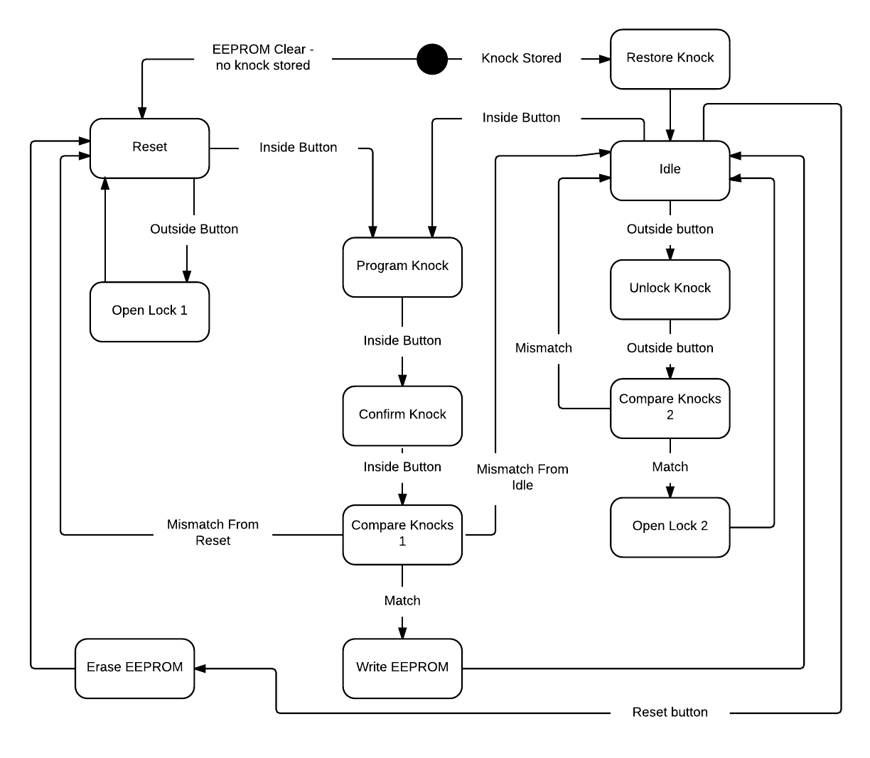
Software Flowchart

Slide 3
Software Issues
Knock sensor threshold.
Knock time threshold.
Button press not instantly going low after releasing it.
Initial design not in line with specification.
Microcontroller clock frequency too low.
DebugWire issues while prototyping.
PORTB5 stuck outputting 5V.

Slide 4
What I Learned
Familiarized myself with the Atmel AVR studio tools and programming libraries.
Learned to compromise with team members.
Learned to use the tools in the EPL.
Pushed myself to meet project goals.
Established trust in my fellow team members.

